Slide 1
customer insights and strategic recommendations
A Data-Driven Approach to Optimize Marketing Strategies
ADEPEJU ADIGUN

Slide 2

Aligning Goals with Metrics
Business Objective
How can each KPI help the potential growth of your business?
RFM Score - Retain high value with personalised offers.
Total Orders - Identifies customer buying frequency to inform campaign targeting
Revenue - Identifies top performing customer groups to nurture further.
Average Order Value (AOV) - Designs strategies to boost average order value
Customer Count - Identify opportunities for acquisition and retention
To increase customer lifetime value by targeting high value segments and improving engagement strategies
Notes:
So our business objective is to increase our customer lifetime value by
targeting our high value segments/customers through engagement strategies, like emails! These are the KPIs we have featured in our dashboard that provide the foundation for making informed decisions that align with other objective.

Slide 3
Segmenting for success
Behavioral
Demographic
Geographic
RFM
Notes:
These are our 4 analysis points, each one aligns with the CEO’s goals in different ways,
Behavioural Segmentation - Shows how turning occasional buyers into repeat customers can improve customer retention and revenue
D- Illustrates how customer demographics helps tailor marketing strategies and drive business decisions by aligning them with purchasing behaviour
G- Shows how helping tailor marketing strategies to regional trends improves local engagement and conversions
RFM- Displays how helping to target high value, frequent buyers while re-engaging at-risk and lost customers to boost retention

Slide 4
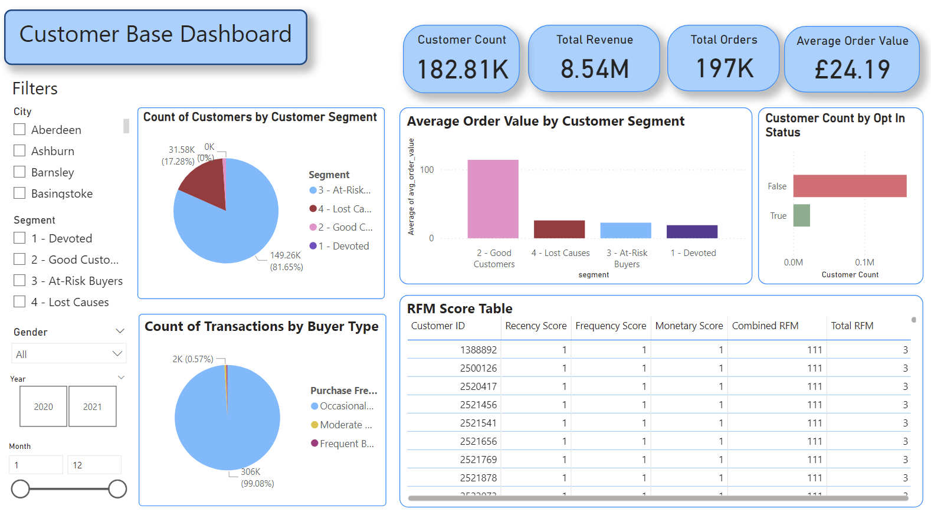
Dashboard Overview

Slide 5
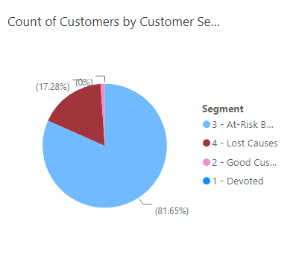
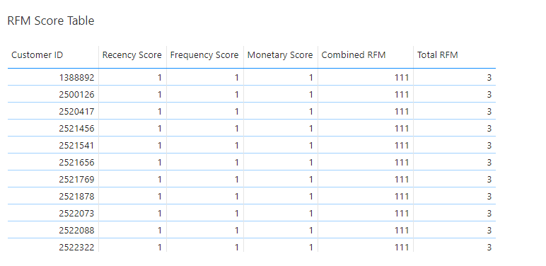
Segmenting by RFM Analysis
RFM Segmentation divides customers into groups based on:
Recency
Frequency
Monetary
Segment | RFM Score Range
Devoted | ≥ 9
Good Customers | 6 - 8
At-Risk | 4 - 5
Lost Causes | <4
Notes:
Customer Segmentation:
Devoted Customer: 1
Good Customers: 1.97K (1.08%)
At-Risk Customers: 149.26K (81.65%)
Lost Causes: 31.58K (17.28%) No frequent buyers in our lost causes segment,0.35% of buyers in lost causes = moderate buyers and 99.65% = occasional buyers
Key Insights:
The majority of the customer base consists of At-Risk (81.65%) and Lost Causes (17.28%).
Occasional buyers dominate across all segments, representing 99.08% of total transactions (306K).
Good Customers have the highest AOV at £114.11 despite being a small percentage of the total.
The RFM Table is available for export, containing detailed RFM scores for each customer.

Slide 6
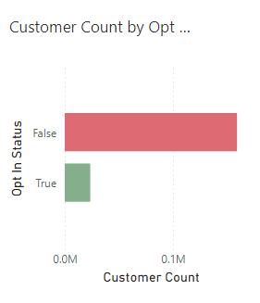
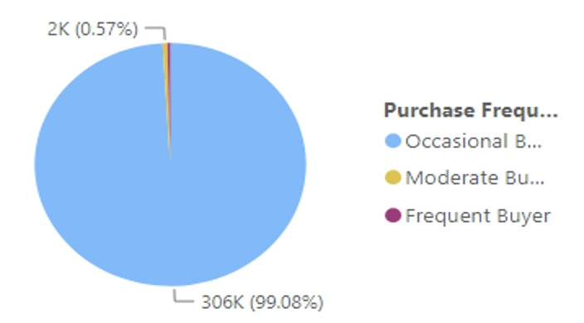
Understanding Customer Behaviour
Behavioral Segmentation divides customers into groups based on:
Purchasing patterns
Customer Interaction
Insights
Frequent: 0.35%
Moderate: 0.57%
Occasional: 99.08%
Open in Power BI
Notes:
Purchasing frequency
Frequent: Very few customers are highly loyal, therefore there’s an opportunity to improve customer retention
Moderate: Has the potential to become frequent buyers with more targeted incentives
Occasional: Most customers buy infrequently, displaying low engagement and a lack of loyalty
Opt-in Status: Regardless of segment or other filters, a significant majority of customers are not opted in
159K+ customers are opted-in in comparison to the 23.5K who are opted in.
This highlights a major opportunity to improve engagement strategies.

Slide 7

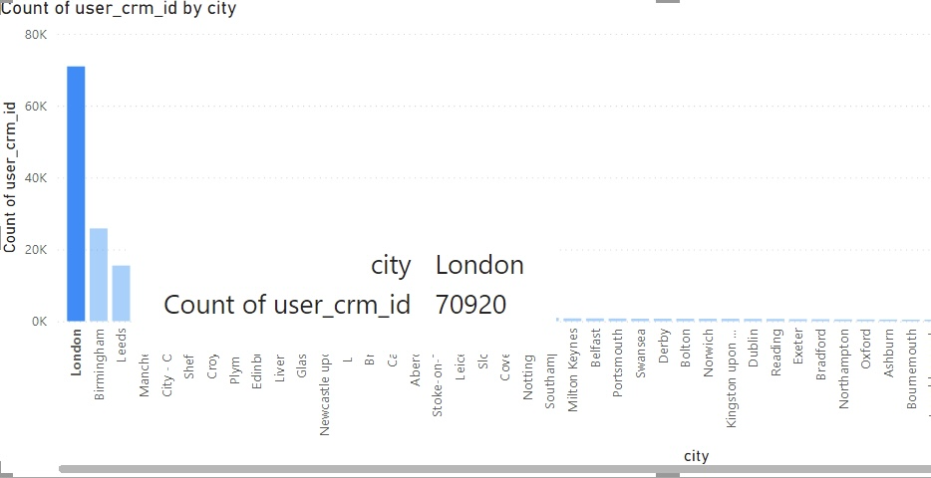


Where Are Our Customers?
Geographical Segmentation divides customers into groups based on:
Cities
Insights
London: 1.19%
Birmingham: 1.24%
Leeds: 0.97%
Manchester: 1.14%

Slide 8
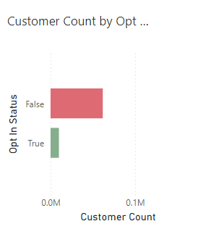
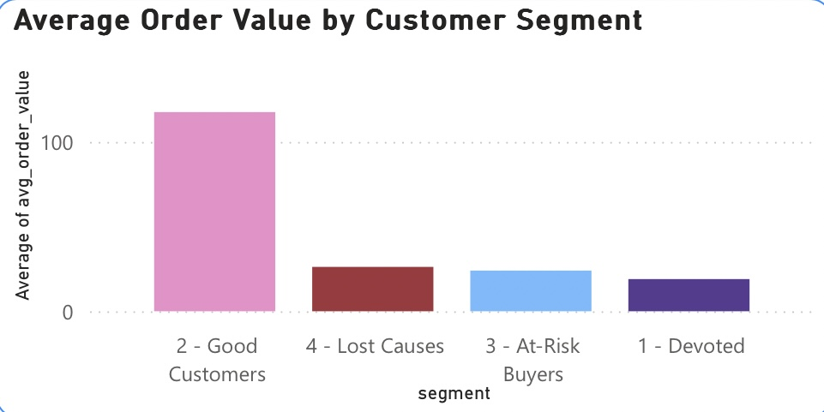
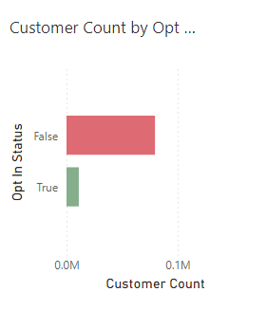
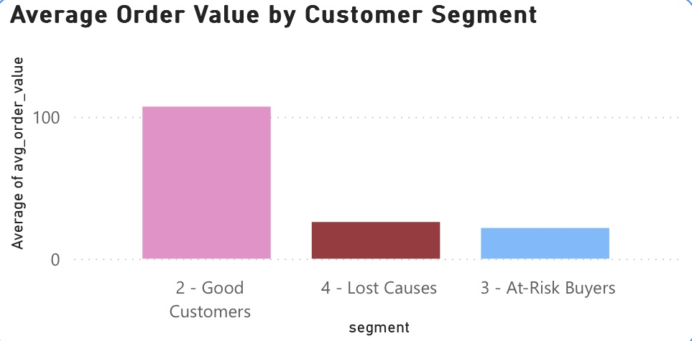
Who Are Our Customers?
Demographic Segmentation divides customers into groups based on
Female
Insights
Female customers:
Higher AOV (£25.67 per order).
More moderate buyers.
Higher opt-in rate (13.76%).
Male
Male customers:
Higher revenue contribution (4.10M total).
More frequent orders.
Lower opt-in rate (12.19% vs. 87.81 % not opted in).
Gender

Slide 9
Actionable Strategies for Growth
Behavioral
Demographic
Geographic
RFM
Reward frequent buyers
Boost female opt-ins
Personalize London campaigns
Retain good customers
Convert occasional buyers
Engage opted-in males
Target top cities
Re-engage At-risk customers
Notes:
BEHAVIOUR:
Introduce subscription models or exclusive memberships for frequent buyers.
Convert occasional buyers into repeat customers with loyalty programs and personalized deals
DEMOGRAPHIC:
Increase opt-in rates for women with tailored incentives like free shipping and exclusive offers
Strengthen male customer engagement with premium product promotions and segmented campaigns.
GEOGRPHIC:
Use personalized messaging in London to stimulate high value repeat buyers.
Focus campaigns on top-performing cities like London, Birmingham, Leeds, and Manchester
RFM:
Retain Good Customers with exclusive rewards and personalized campaigns.
Re-engage At-Risk customers using targeted discounts and curated product suggestions.

Slide 10
Conclusion
ACTION PLAN
🎯 Target RFM Segments
🌍 Prioritize Cities
📩 Boost Opt-In Rates
🛒 Drive Loyalty Programs
📊 Monitor and Optimise
Notes:
ACTION PLAN
This data driven approach ensures marketing efforts align with customer needs, maximising ROI,
increasing customer retention and driving long term profitability.
It strengthens relationships by building customer loyalty and enhancing the overall efficiency of business strategies.

Slide 11
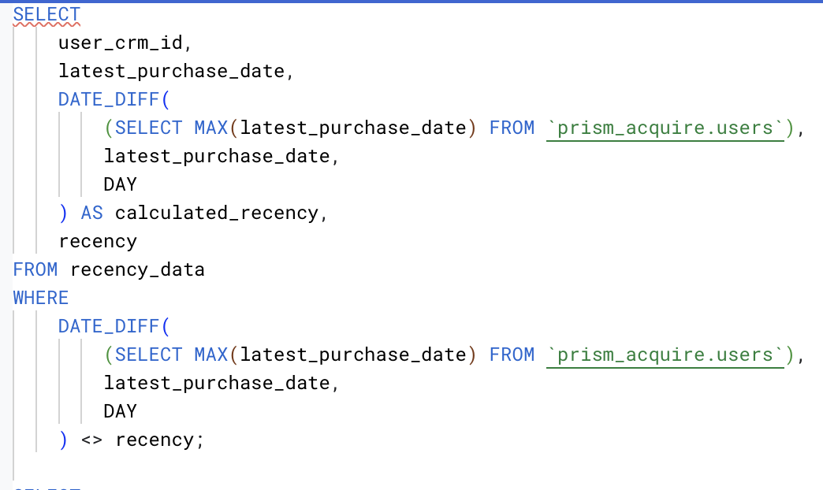
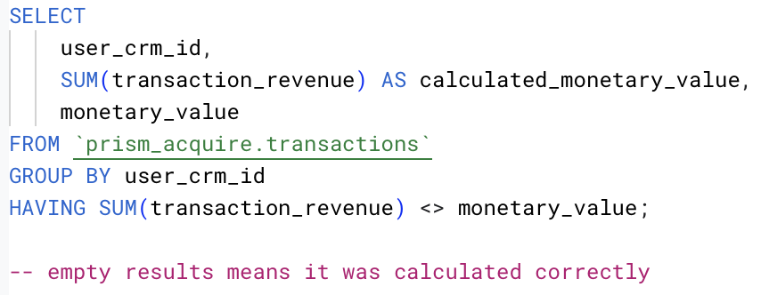
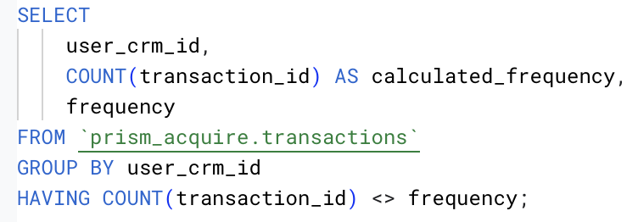
APPENDIX

